Slide 1
Hardware characteristics
Made by Salova S. A.

Slide 2
Learning Outcomes
By the end of this lesson, you should be able to:
Identify the hardware components of a personal computer system.
List and characterize major input and output devices.
Explain the functions of processing, storage and connecting devices.
Realize the significance of each hardware component in processing information.
Identify general trends in the development of the different hardware components of a computer.

Slide 3
Lesson Steps
Forming groups
Revision
Definition
Classification
Word order
Web search
Presentation
Reflection
 | your name | Name the item | classify | gap-fill | match | word order | make a state-ment | find in the Internet | present your item
1 | Tanya

Slide 4
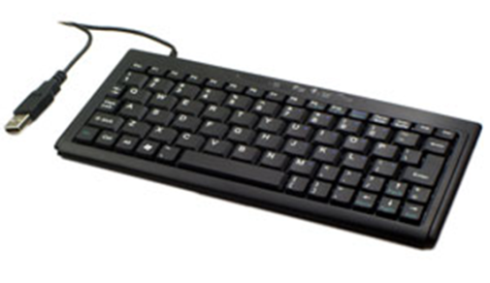
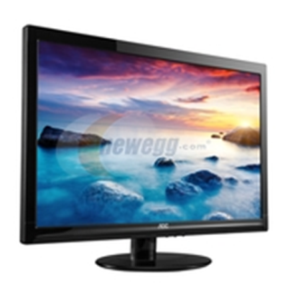
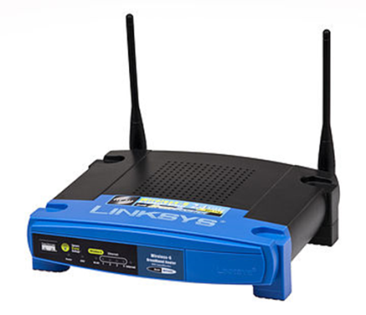
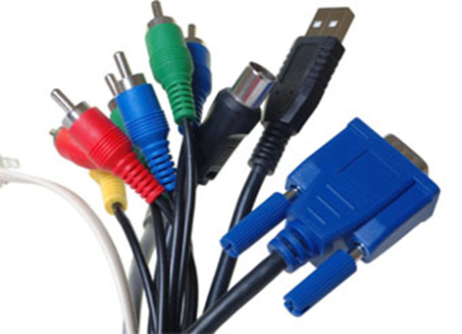
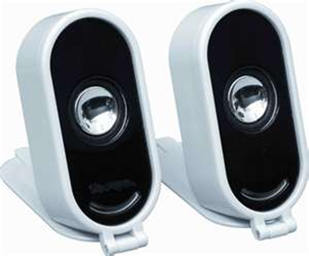
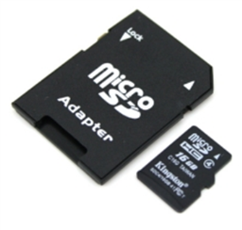
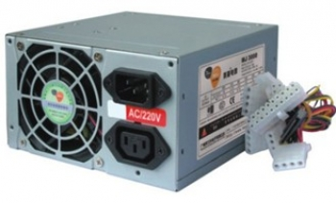
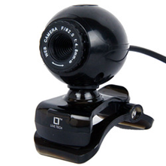
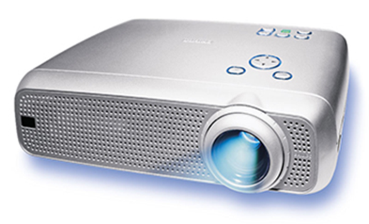
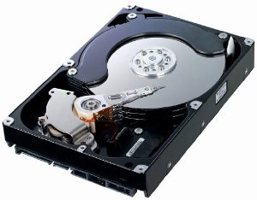
Name a Hardware Item
Hardware – physical devices that make up a computer (or computer system)

Slide 5
Classify the Following Items
Input device
Gaming wheel
Output device
Gamepad
LCD monitor
Touchpad
Printer
Iris scanner
Speakers
Trackball
Keyboard
Webcam
Bar code scanner

Slide 6
What is Hardware?
keyboard, physical, enter, system, electromechanical, scanners, devices, produce, computer, mouse, data, understand, converts
Hardware is the physical component of a computer system. It refers to the electromechanical parts and devices that make up a computer.
Input hardware is used to enter data into a computer by encoding via keyboard, direct reading through scanners or pointing devices like the mouse. Input hardware converts data, e.g. text, image, drawings, into a form that a computer can understand and use.
Hardware used to produce the output of the computer system after processing data is called output devices.

Slide 7
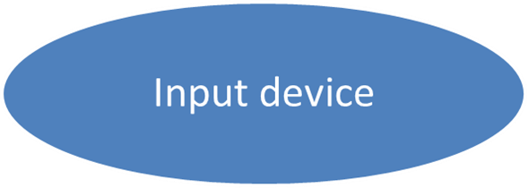
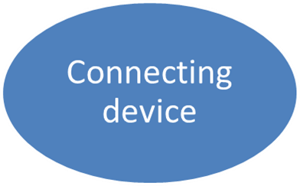
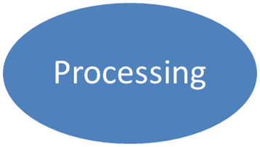
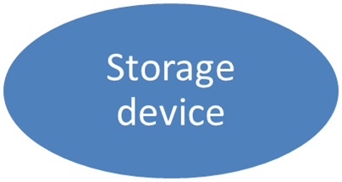
Six Categories of Hardware

Slide 8
Match the items with the definitions
Input devices
Output devices
Processing devices
Connecting devices
Storage devices
Tele-communication devices
A. store information for use at a later time
B. let you connect peripherals to your computer
C. enter information and commands
D. send information to and receive it from another person or computer in a network
E. are the 'brain' of the computer
F. take information from the computer and convert it into real world things

Slide 9
What devices can be named input devices?
… , … , … can be named input devices.

Slide 10
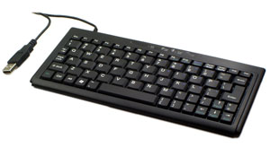
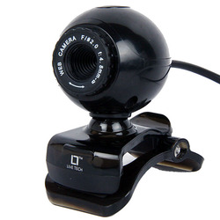
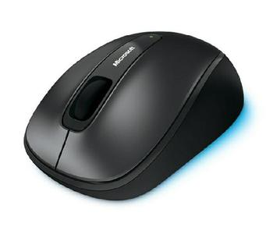
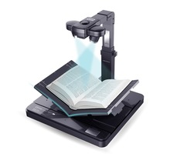
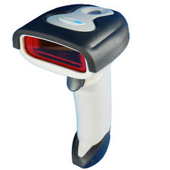
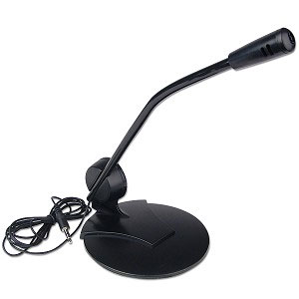
Six Categories of Hardware
Input devices

Slide 11
What six groups can be defined among input devices?
They are ….
Use the information from the “gap-fill” text

Slide 12
Common Input Devices
Input devices
Pointing devices
Game controllers
Keyboards Styluses
Microphones
Scanners
Cameras

Slide 13
Input Devices Key Features
Name | Function | Features
Keyboards | input devices for notebooks and desktops to enter information and commands | Ergonomics Connectivity Variety of hot keys
Stylus | input devices for PDAs and tablet PCs to enter information and commands | Ergonomics Size
Pointing Device | Input commands | Ergonomics Size Connectivity Battery Life
Game Controller | control screen actions while gaming | Ergonomics Connectivity Weight and size Extra features

Slide 14
Input Devices Key Features
Name | Function | Features
Scanners | convert information that exists in visible form into electronic form | Connectivity Resolution Colour accuracy
Webcam | captures still image or video as a series of 1s and 0s | Resolution Autofocus Microphone Lens Connectivity Construction

Slide 15
What devices can be named output devices?

Slide 16
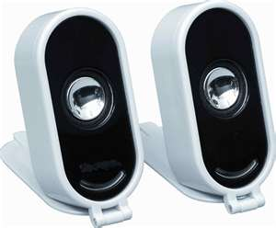
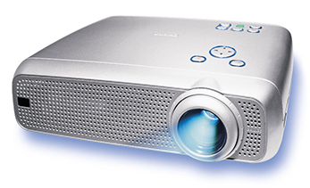
Six Categories of Hardware
Output devices
What groups can be defined among output devices?

Slide 17
Common Output Devices
Output devices
Speakers
Printers
Monitors
Head-phones
Laser
Inkjet

Slide 18
Output Devices Key Features
Name | Function | Features
Monitors | display the video and graphics information generated by the computer | Screen Size Resolution Contrast Ratio Brightness Ports
Printers | print the data from a computer into a printing material like paper | Speed Resolution Connectivity Type
Speakers | output sound generated by the computer, make speech or music audible | Sound Quality Connectivity
Head-phones | output sound generated by the computer, make speech or music audible | Sound Quality Connectivity

Slide 19
What devices can be named storage devices?

Slide 20
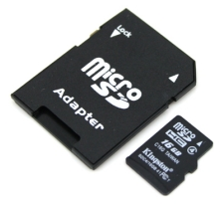
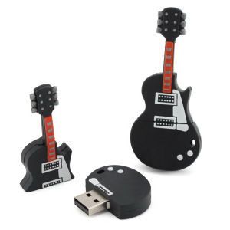
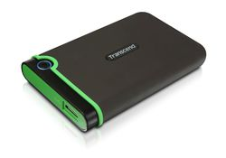
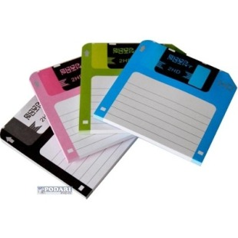
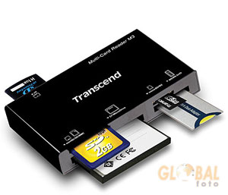
Six Categories of Hardware
Storage devices
What groups can be defined among storage devices?

Slide 21
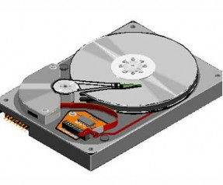
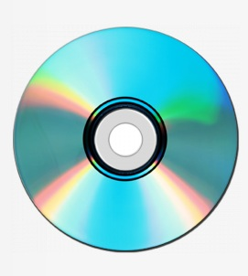
Common Storage Devices
Storage Media
Magnetic
Optical
Flash

Slide 22
Storage Devices Key Features
Name | Function | Features
Hard Disks | also, store, information, permanently, retrieve and | Capacity Speed
CD, DVD | can be read, using, store, data, as patterns, that, light, of dots | Capacity R or RW
Flash | electronic, store, moving parts, circuits, data, on, with, no | Size Compatibility Storage capacity
CPU Main Memory | processed, store, CPU, any, that, data, or, are, instructions, by, the | Efficiency Cache Bandwidth
RAM | processed, contain, being, any, that, data, that is | Volatility Bandwidth
ROM | program, the, hold, 'boot up' | Type Speed Endurance

Slide 23
Storage Devices Key Features
Name | Function | Features
Hard Disks | permanently store and also retrieve information | Capacity Speed
CD, DVD | store data as patterns of dots that can be read using light | Capacity R or RW
Flash | store data on electronic circuits with no moving parts | Size Compatibility Storage capacity
CPU Main Memory | store any data or instructions that are processed by the CPU | Efficiency Cache Bandwidth
RAM | store and retrieve data, is referred to as a computer's memory | Volatility Bandwidth
ROM | hold the ‘boot up’ program | Type Speed Endurance

Slide 24
What devices can be named processing devices?
Use the key-words in the next slide

Slide 25
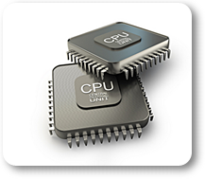
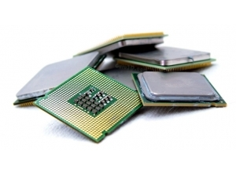
Six Categories of Hardware
Processing
CPU
What is CPU and what are the key characteristics of CPU?
'brain‘, computer, carry out, instructions.
E………..y, C….e, B……..h, C…….s

Slide 26
CPU Key Features
Name | Function | Features
CPU | 'brain‘, computer, carry out, instructions. | E………..y C….e B……..h C…….s
Name | Function | Features
CPU | is the 'brain' of the computer. It is the device that carries out software instructions. | Efficiency Cache Bandwidth Cores

Slide 27
What devices can be named connecting devices?

Slide 28
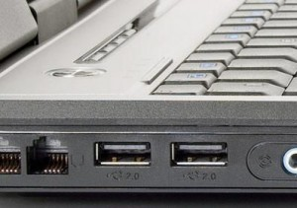
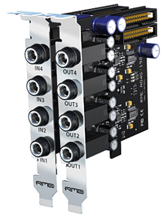
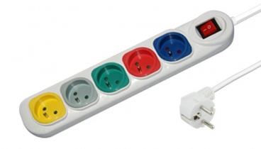
Six Categories of Hardware
Connecting devices

Slide 29
What information have you found at home about hardware manufacturing companies?
Exchange your cards, choose a company and try to find information about their latest devices.
Name – function – features

Slide 30
Presentation tips
We’d like to tell you about …
It’s the latest device of ….
It is meant for …
The key features of the devise are …

Slide 31
You’ve been filling your progress cards. Raise them up please.
Look at your line and think if you’ve been active and efficient enough.

